Slide 1

Scripting Languages
Module 7
File Manipulation and Editing Using Sed

Slide 2
Contents
Introducing the stream editor sed and simple automated text editing
Using sed to parse text and data files
Text substitution
Writing and executing more complex sed commands

Slide 3
Learning Outcomes
After finishing this module, you should be able to:
Understand and execute scripts that make use of sed to perform simple search and update operations
Write scripts that can parse text in a meaningful way

Slide 4
What is sed?
The Stream Editor (sed) can be used to simplify the parsing and formatting process
sed works by searching through text line by line making changes based on given commands
sed 'command' [Input file]

Slide 5
sed
s is for substitution

Slide 6
The s command
One of the most common features of sed is to act as a find and replace operation.
The command to replace a found pattern with another is s for substitute
sed 's/color/colour/' inputfile.txt

Slide 7
s -> structure
The Substitute command has four (4) parts:
s | The Substitute command
/../../ | Delimiter(s)
String_A | Regular expression pattern / search pattern to be replaced
String_B | Replacement string
sed 's/color/colour/'

Slide 8
s -> structure
It also requires an input file/source to operate on
sed 's/color/colour/' inputfile.txt

Slide 9
s command with Global Replacement
By default, sed only changes the first occurrence of the specified replacement string on each line it encounters in a file/source
To disable this default behaviour and have sed change all instances of a pattern to the replacement pattern, use the g option immediately after the final delimiter.
sed 's/color/colour/g' inputfile.txt

Slide 10
sed
Examples of Application

Slide 11
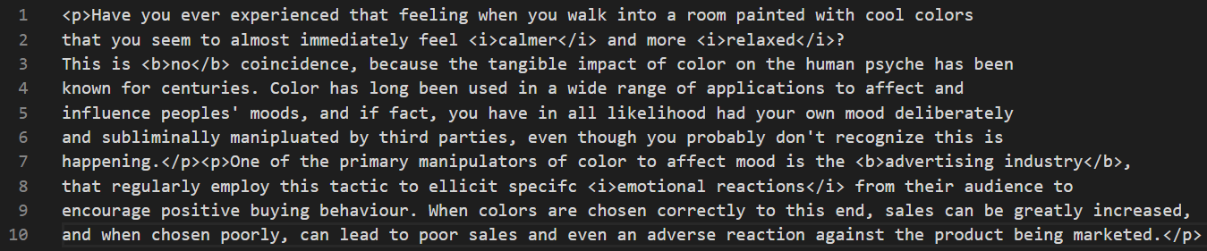
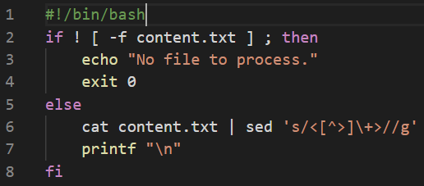
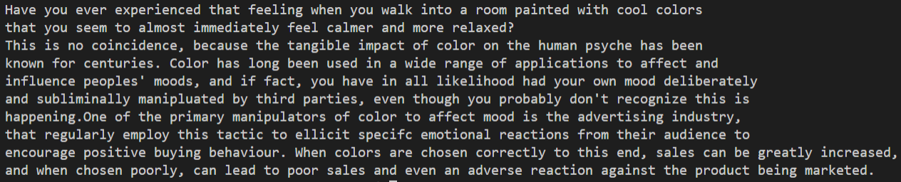
sed source -> cat to screen

Slide 12
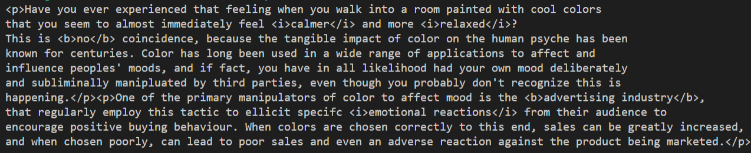
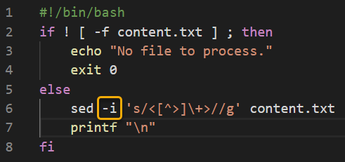
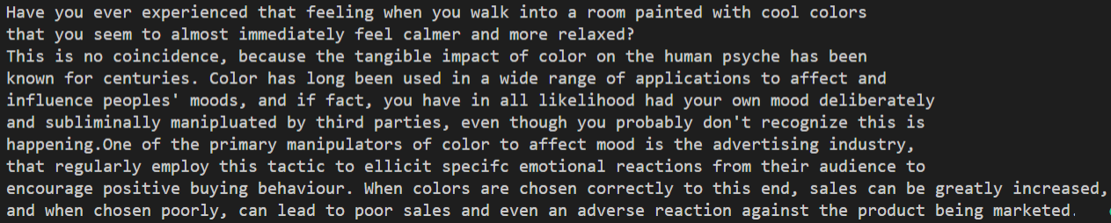
sed source -> file in place
i
in place

Slide 13
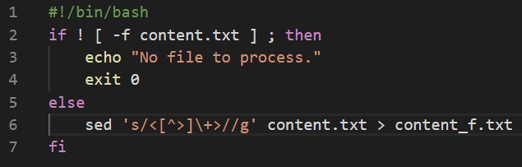
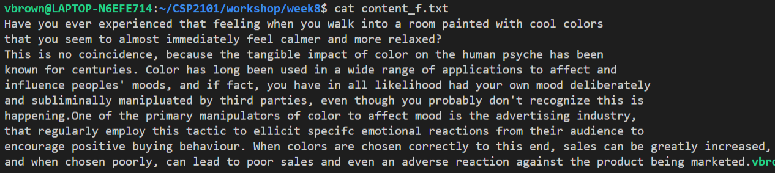
sed source -> file to new file

Slide 14
sed
Using Alternate Delimiters

Slide 15
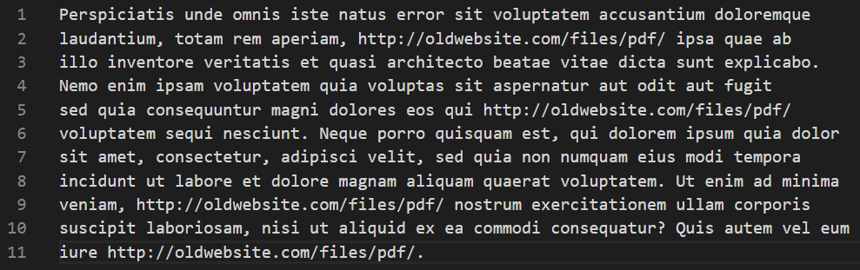
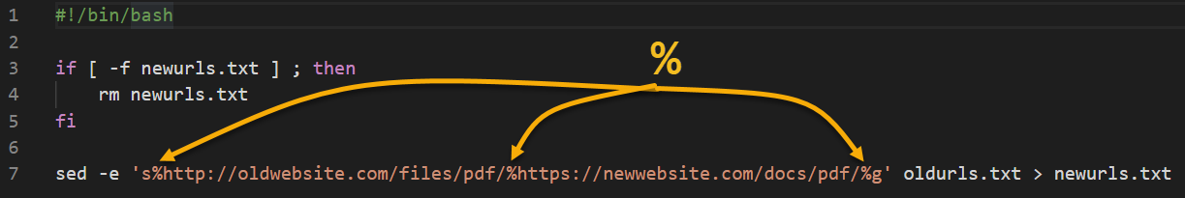
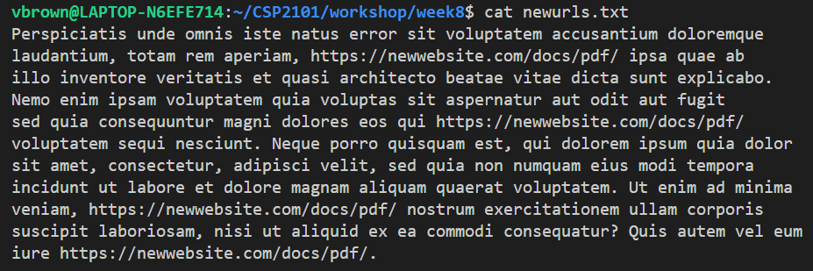
Alt delimiters for special cases

Slide 16
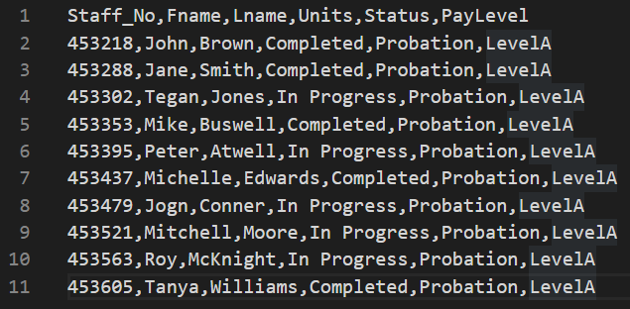
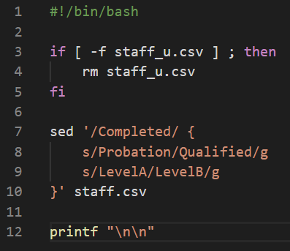
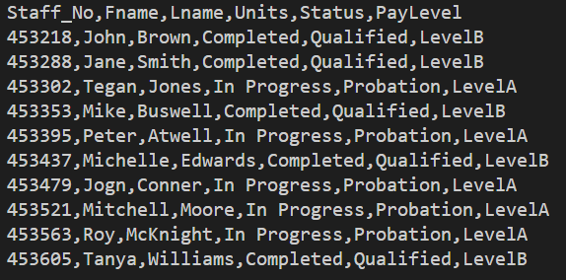
Single pattern -> multiple line changes

Slide 17
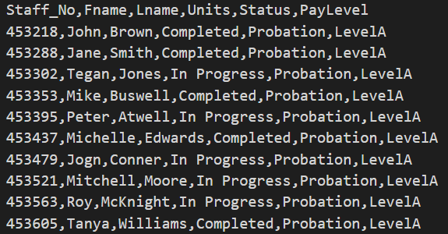
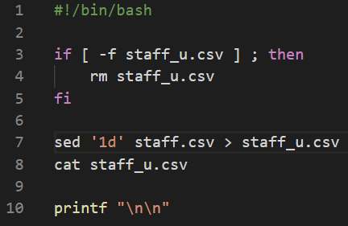
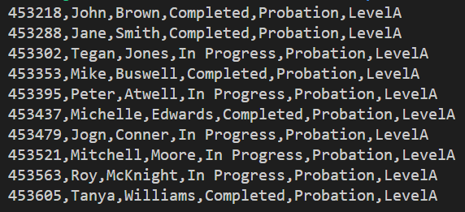
Delete specific line(s) by number
Removes the header line from the output file

Slide 18
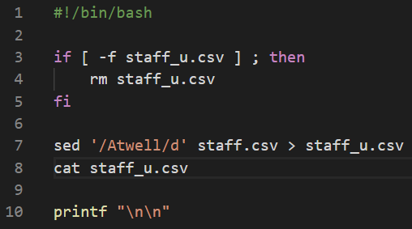
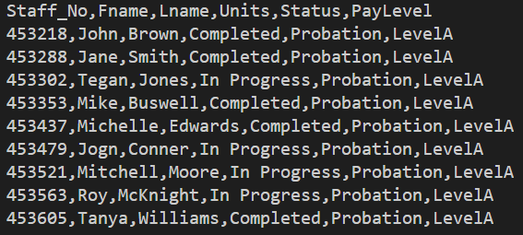
Delete line(s) based on patten
Removes Peter Atwell’s record from the output file

Slide 19
sed
Multiple Commands

Slide 20
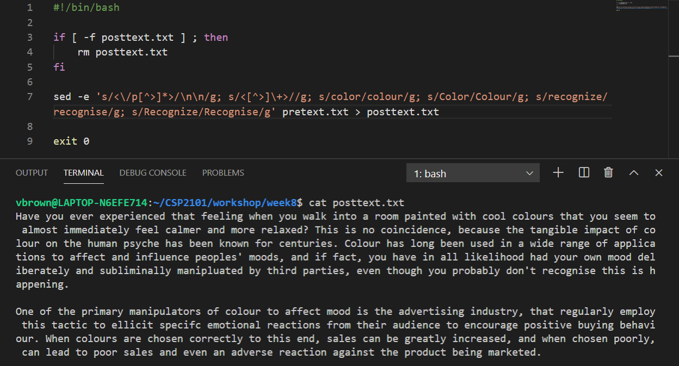
Multiple arguments -> method 1
-e means read multiple commands
Separate each regex with a semi colon (;)
Only one set of quotes required
~/CSI6203

Slide 21
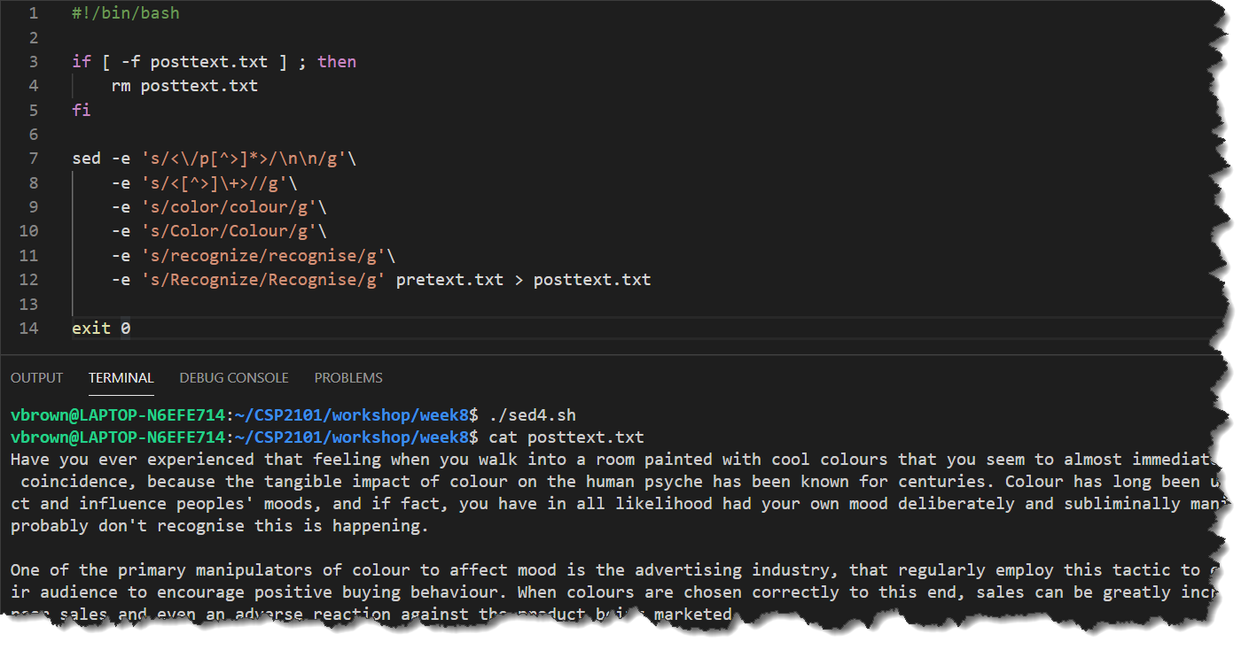
Multiple arguments -> method 2
OVER MULTIPLE LINES FOR READABILITY
Each argument needs its own -e
Each argument requires open/close quotes
Backslashes (\)used to run command across multiple lines
~/CSI6203
~/CSI6203

Slide 22
References and Further Reading
Ebrahim, M. & Mallet, A. (2018). Mastering Linux Based Scripting. (2nd Ed), Chapter 8, pp 141-160
http://www.gnu.org/software/sed/manual/sed.html
http://linux.die.net/man/1/sed
https://www.cyberciti.biz/faq/how-to-use-sed-to-find-and-replace-text-in-files-in-linux-unix-shell/

